Slide 1
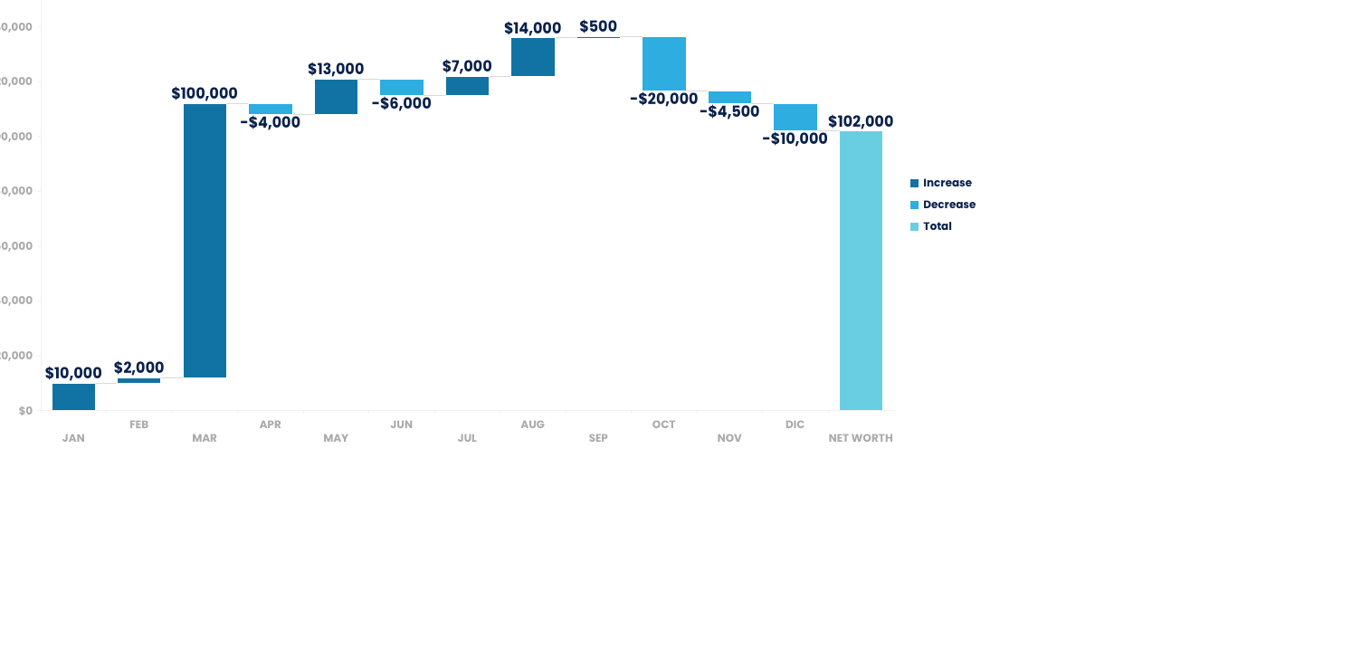
NET CASH FLOW
WATERFLOW CHART TEMPLATE

Slide 2
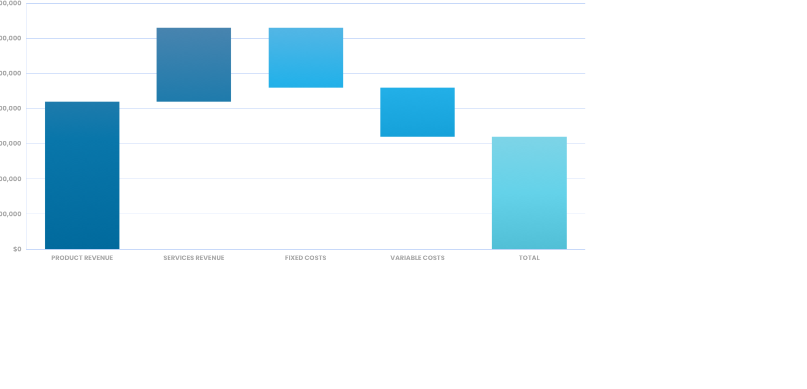
COMPANY PROFIT (IN USD) - 2019
WATERFLOW CHART TEMPLATE

Slide 3
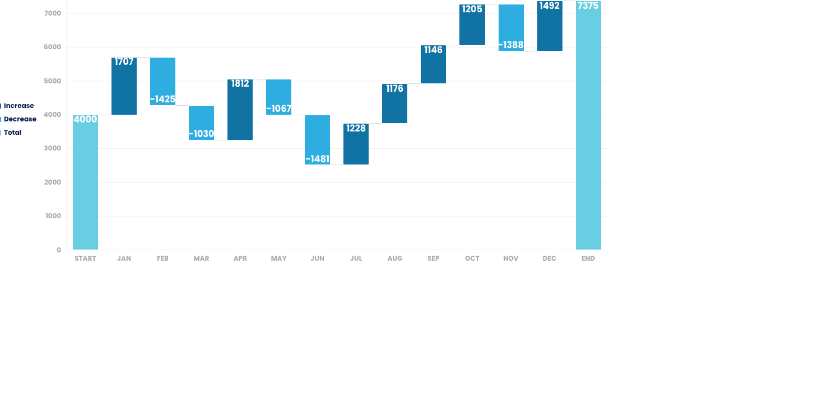
WATERFALL CHART
WATERFLOW CHART TEMPLATE

Slide 4
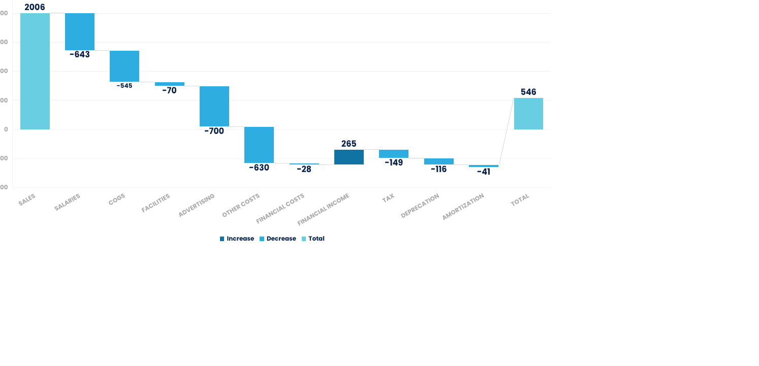
WATERFALL CHART
WATERFLOW CHART TEMPLATE

Slide 5
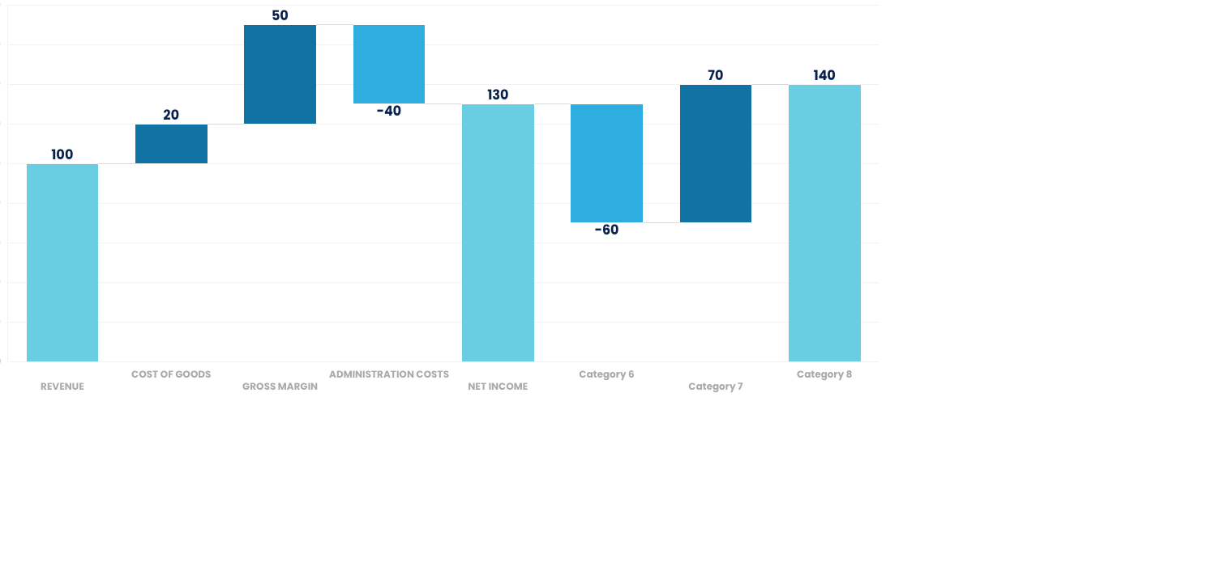
WATERFALL CHART
WATERFLOW CHART TEMPLATE

Slide 6
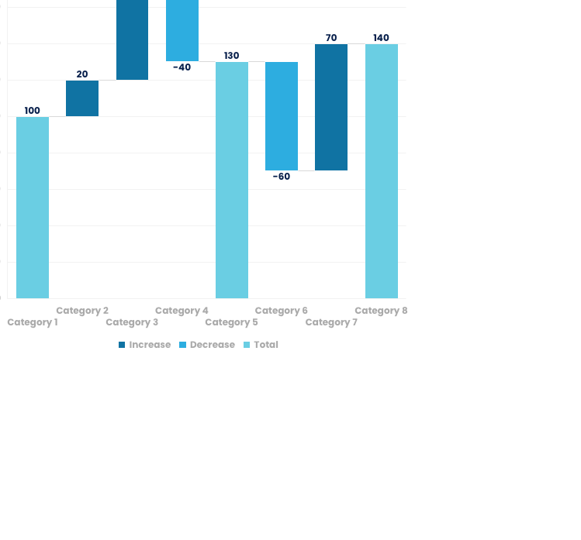
WATERFALL CHART
WATERFLOW CHART TEMPLATE
YOUR TITLE 01
Green marketing is a practice whereby companies seek to go above and beyond traditional.
YOUR TITLE 02
Green marketing is a practice whereby companies seek to go above and beyond traditional.
YOUR TITLE 03
Green marketing is a practice whereby companies seek to go above and beyond traditional.

Slide 7
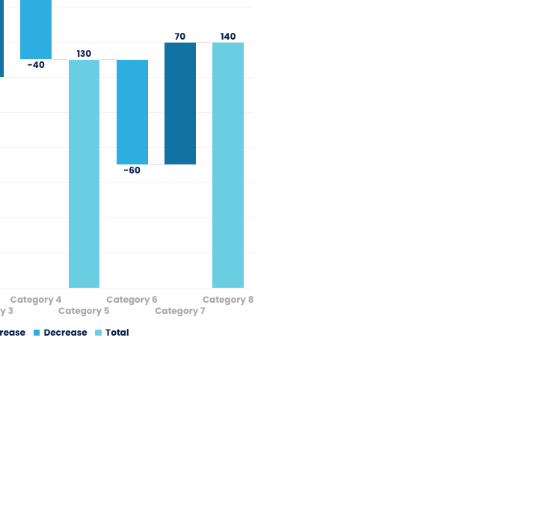
WATERFALL CHART
WATERFLOW CHART TEMPLATE
YOUR TITLE 01
Green marketing is a practice whereby companies seek to go above and beyond traditional.
YOUR TITLE 02
Green marketing is a practice whereby companies seek to go above and beyond traditional.
YOUR TITLE 03
Green marketing is a practice whereby companies seek to go above and beyond traditional.

Slide 8
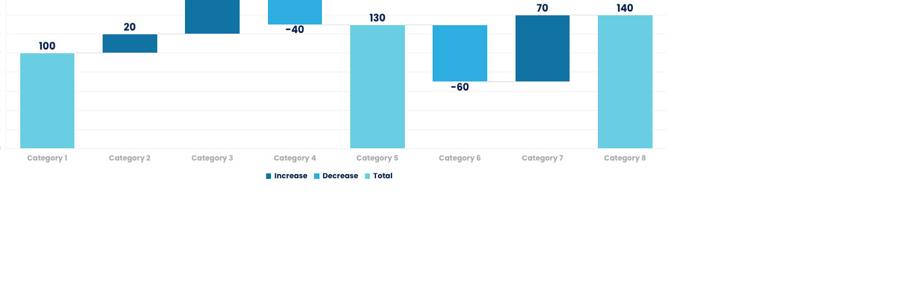
WATERFALL CHART
WATERFLOW CHART TEMPLATE
YOUR TITLE 01
YOUR TITLE 02
YOUR TITLE 03
Green marketing is a practice whereby companies seek to go above and beyond traditional.
Green marketing is a practice whereby companies seek to go above and beyond traditional.
Green marketing is a practice whereby companies seek to go above and beyond traditional.

Slide 9
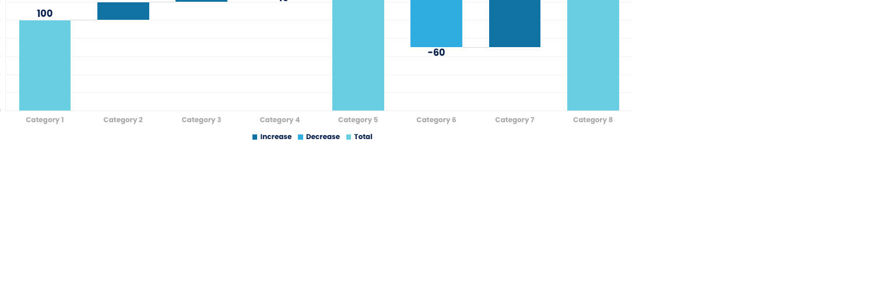
WATERFALL CHART
WATERFLOW CHART TEMPLATE
YOUR TITLE 01
YOUR TITLE 02
YOUR TITLE 03
Green marketing is a practice whereby companies seek to go above and beyond traditional.
Green marketing is a practice whereby companies seek to go above and beyond traditional.
Green marketing is a practice whereby companies seek to go above and beyond traditional.

Slide 10
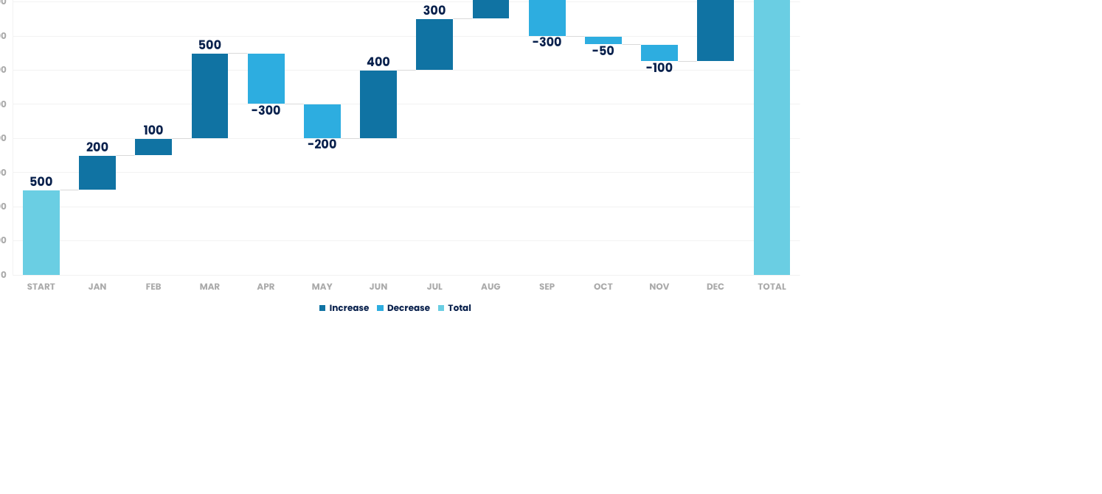
WATERFALL CHART
WATERFLOW CHART TEMPLATE
CASH FLOW IN 2019

Slide 11
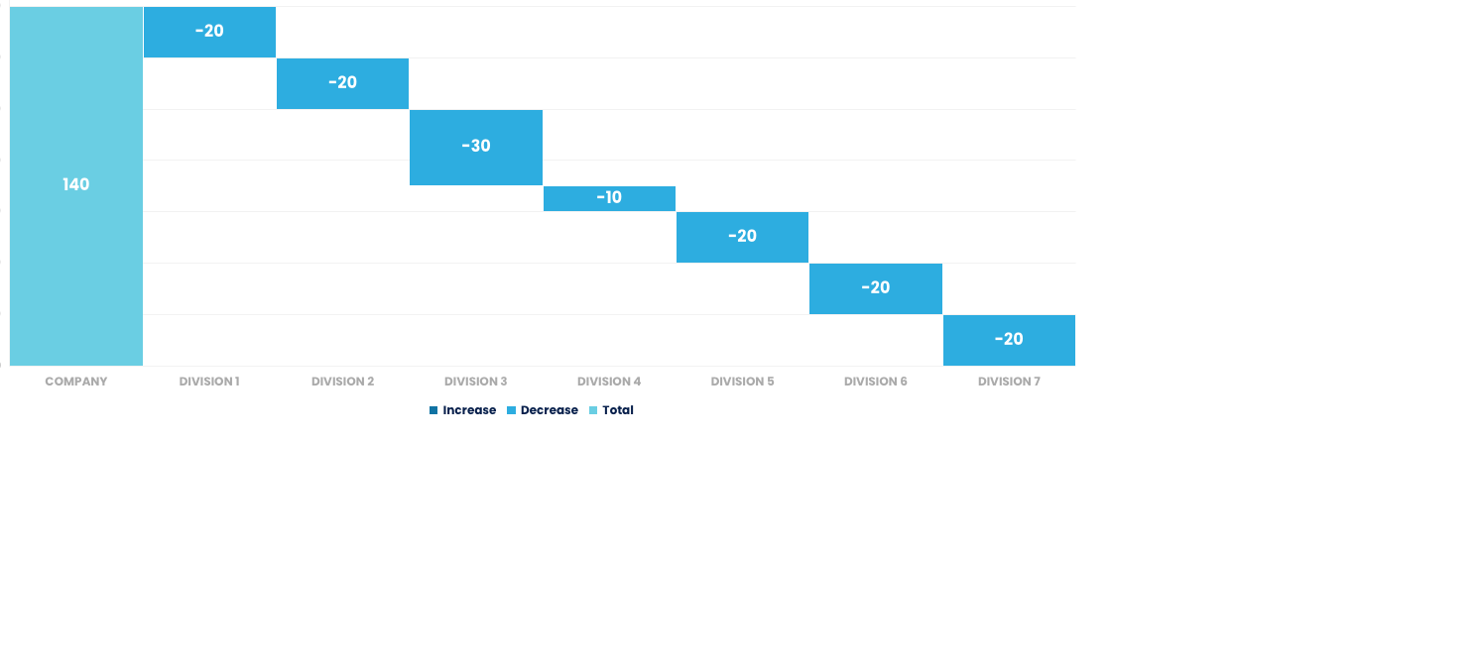
WATERFALL CHART
WATERFLOW CHART TEMPLATE
CASH FLOW IN 2019

Slide 12
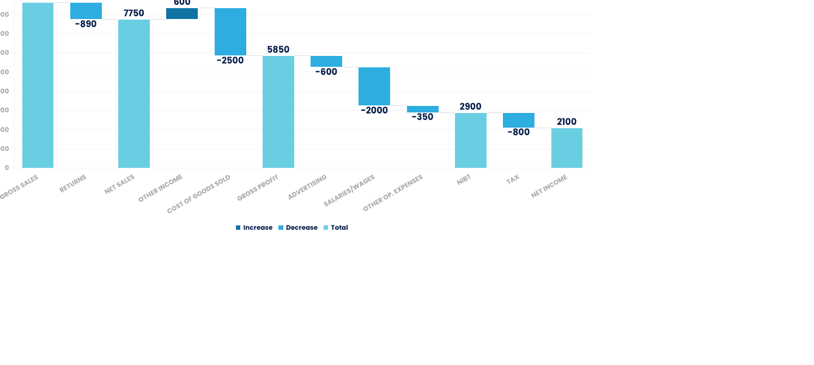
WATERFALL CHART
WATERFLOW CHART TEMPLATE
INCOME STATEMENT 2019

Slide 13
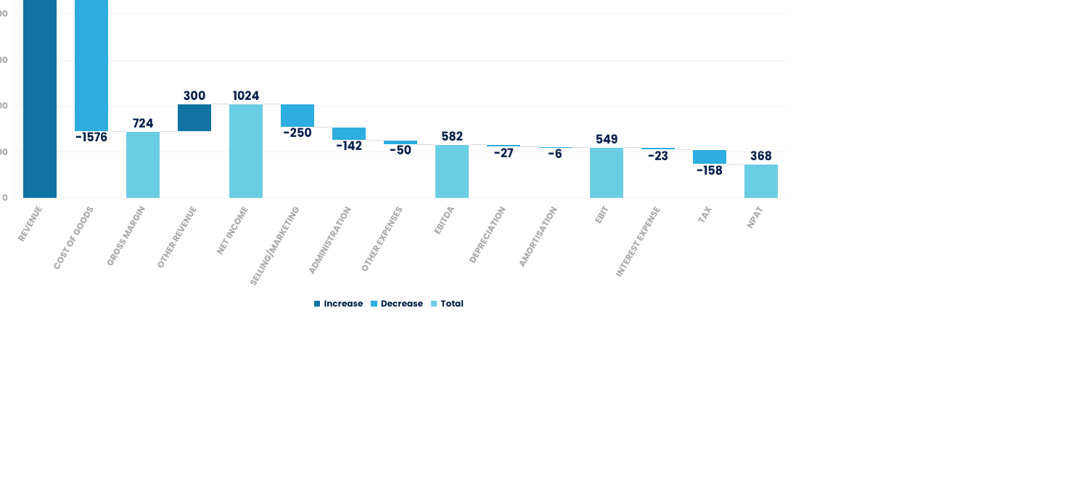
WATERFALL CHART
WATERFLOW CHART TEMPLATE
P&L WATERFALL

Slide 14
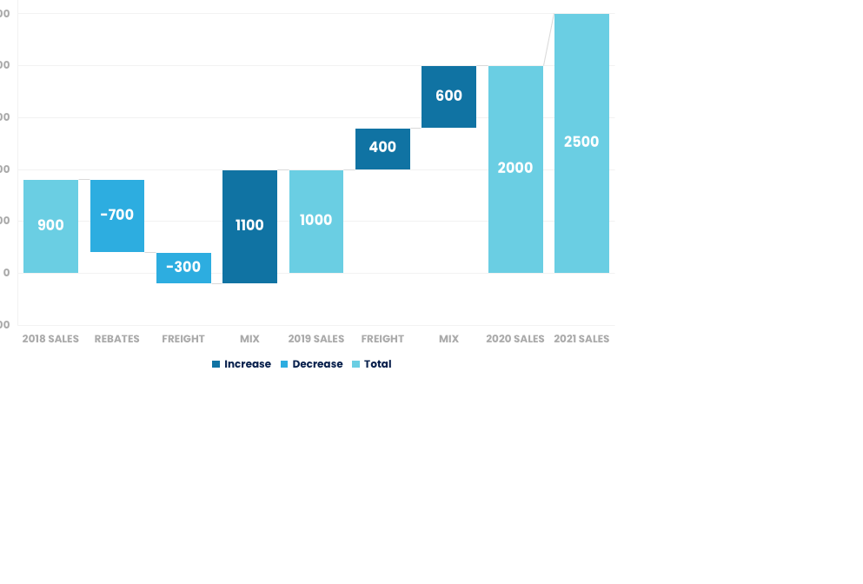
WATERFALL CHART
WATERFLOW CHART TEMPLATE
P&L WATERFALL 2018 - 2021
YOUR TITLE 01
Green marketing is a practice whereby companies seek to go.
YOUR TITLE 02
Green marketing is a practice whereby companies seek to go.
YOUR TITLE 03
Green marketing is a practice whereby companies seek to go.

Slide 15
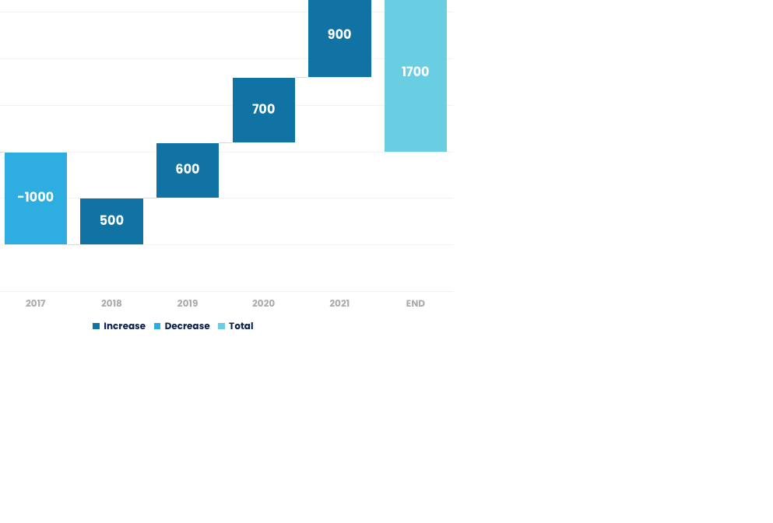
WATERFALL CHART
WATERFLOW CHART TEMPLATE
P&L WATERFALL 2018 - 2021
YOUR TITLE 01
Green marketing is a practice whereby companies seek to go.
YOUR TITLE 02
Green marketing is a practice whereby companies seek to go.
YOUR TITLE 03
Green marketing is a practice whereby companies seek to go.

Slide 16
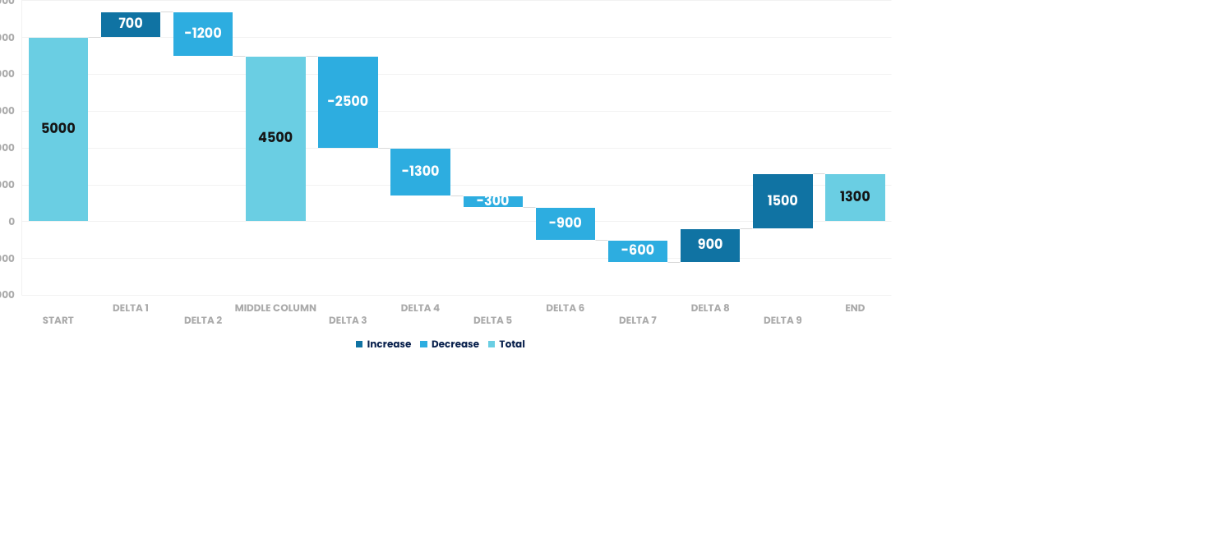
WATERFALL CHART
WATERFLOW CHART TEMPLATE
P&L WATERFALL 2018 - 2021

Slide 17
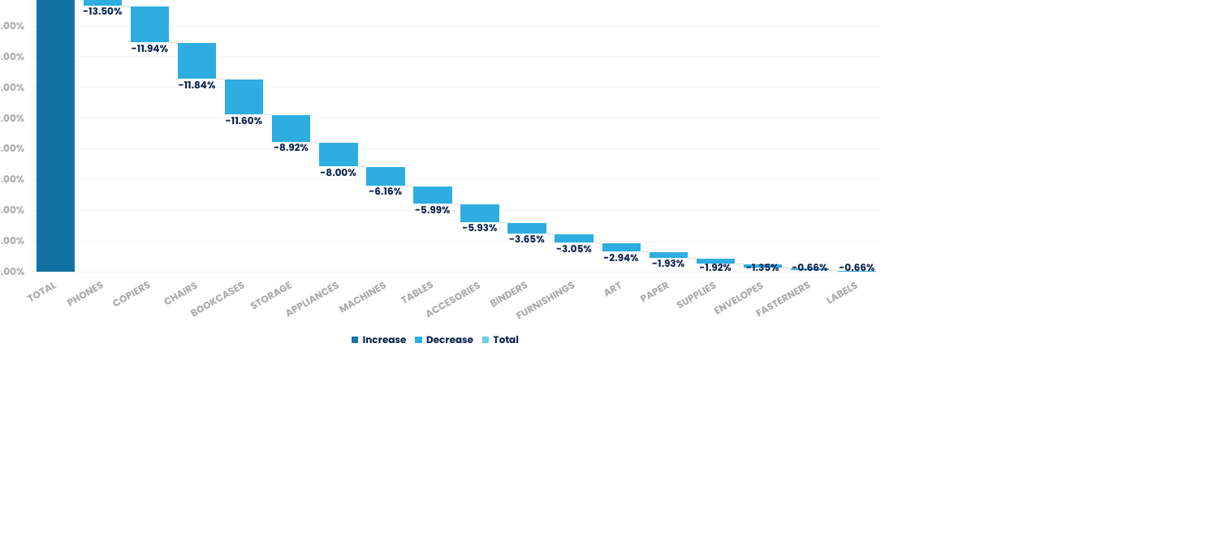
WATERFALL CHART
WATERFLOW CHART TEMPLATE
P&L WATERFALL 2018 - 2021

Slide 18
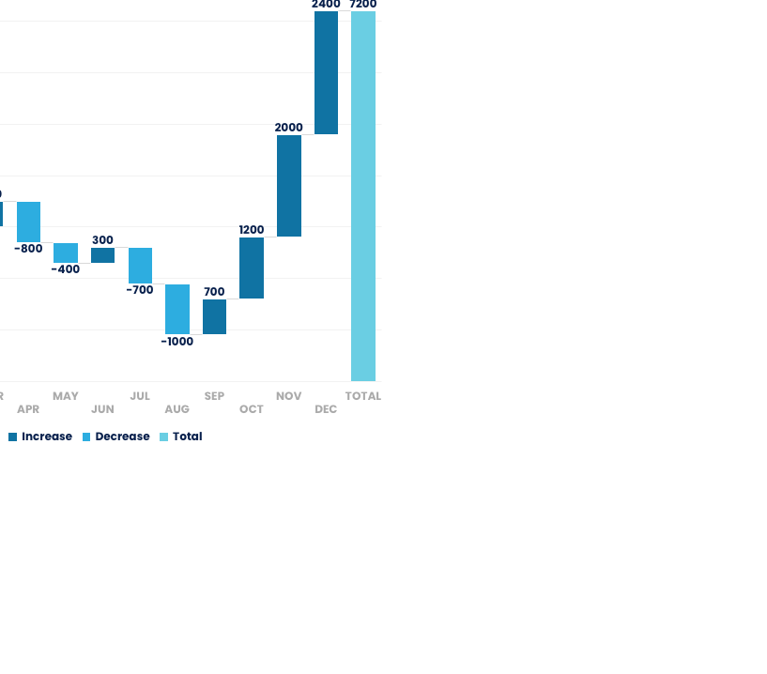
WATERFALL CHART
WATERFLOW CHART TEMPLATE
BASE
DOWN
UP
INCOME
START
0
800
800
JAN
800
0
1000
1000
FEB
1800
0
1200
1200
MAR
3000
0
500
500
APR
2700
800
0
-800
MAY
2300
400
0
-400
JUN
2300
0
300
300
JUL
1900
700
0
-700
AUG
900
1000
0
-1000
SEP
900
0
700
700
OCT
1600
0
1200
1200
NOV
2800
0
2000
2000
DEC
4800
0
2400
2400
END
7200
0
0

Slide 19
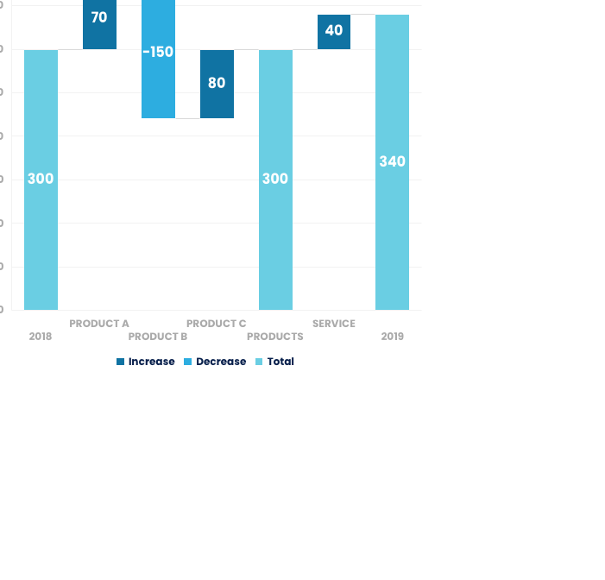
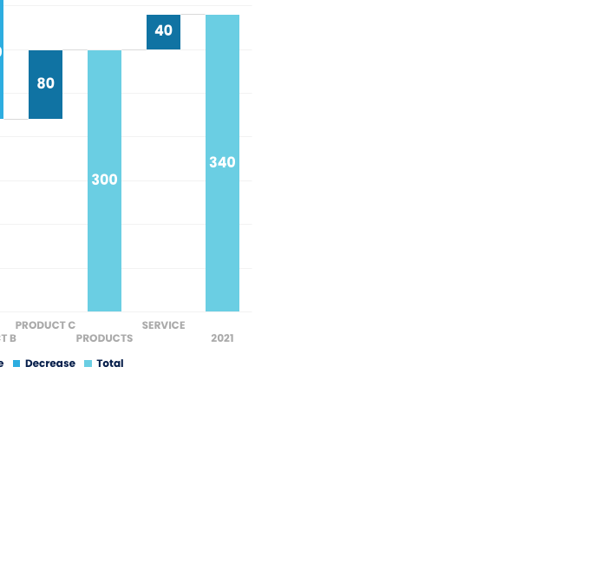
WATERFALL CHART
WATERFLOW CHART TEMPLATE
P&L WATERFALL 2018
P&L WATERFALL 2021

Slide 20
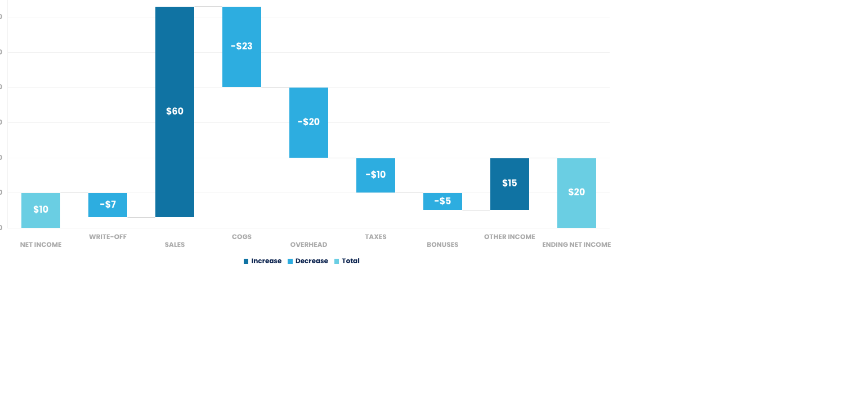
WATERFALL CHART
WATERFLOW CHART TEMPLATE

Slide 21
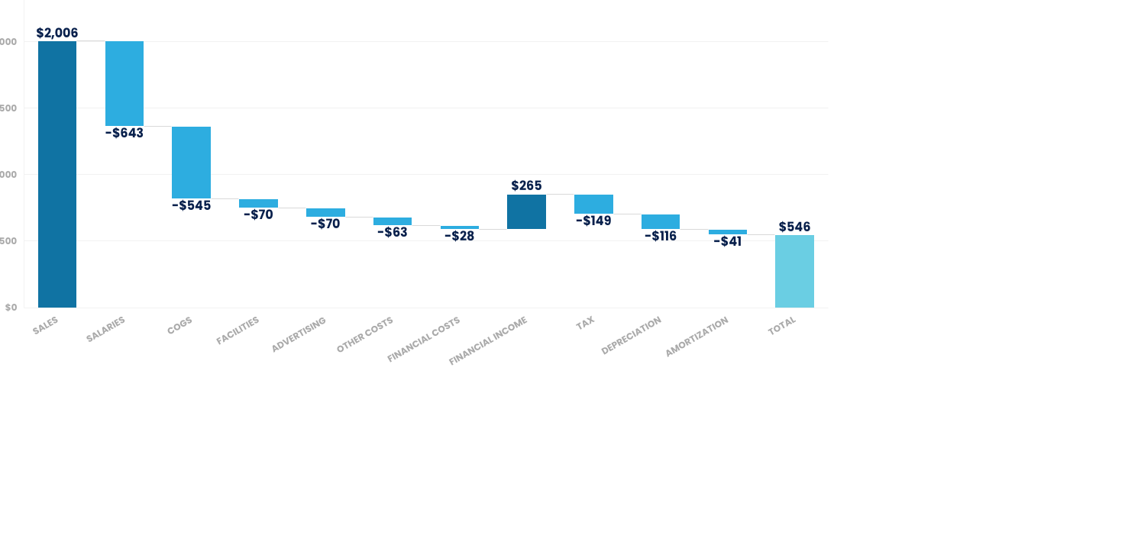
WATERFALL CHART
WATERFLOW CHART TEMPLATE

Slide 22
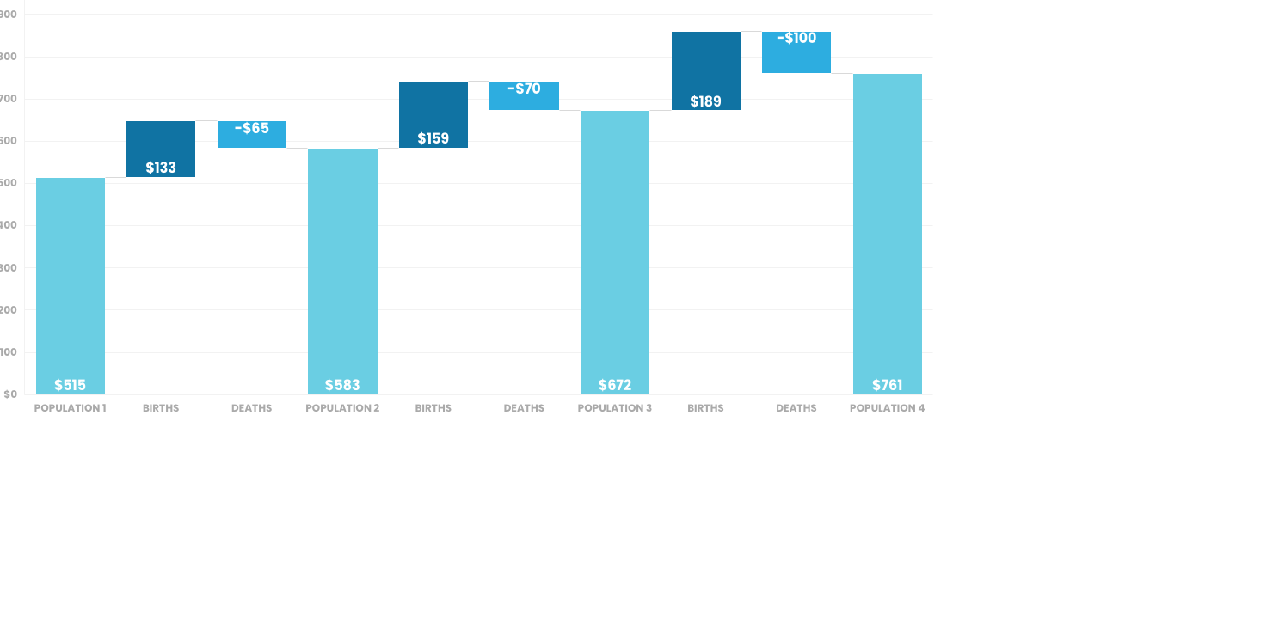
WATERFALL CHART
WATERFLOW CHART TEMPLATE

Slide 23
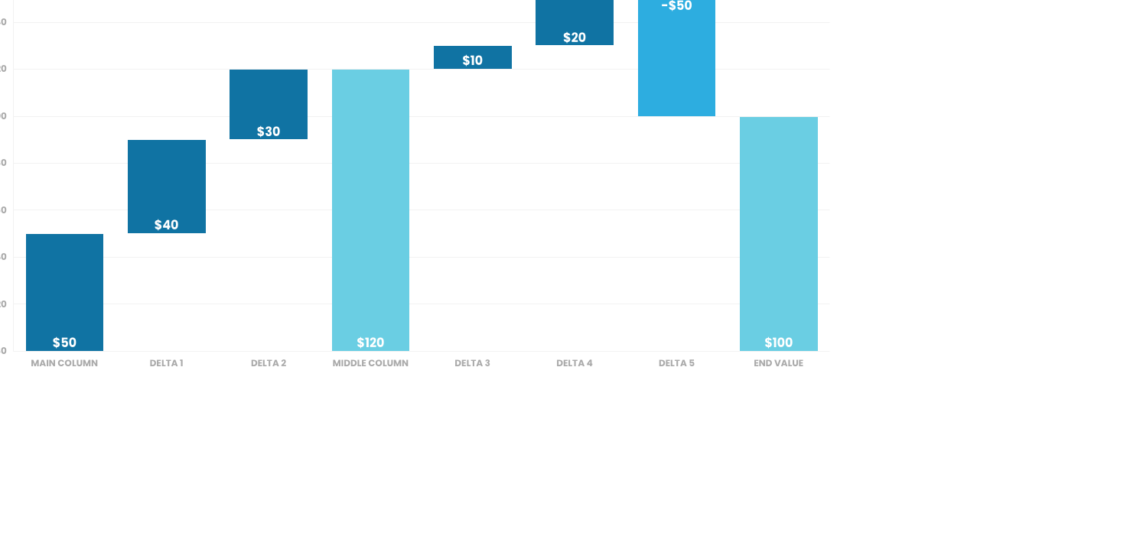
WATERFALL CHART
WATERFLOW CHART TEMPLATE

Slide 24
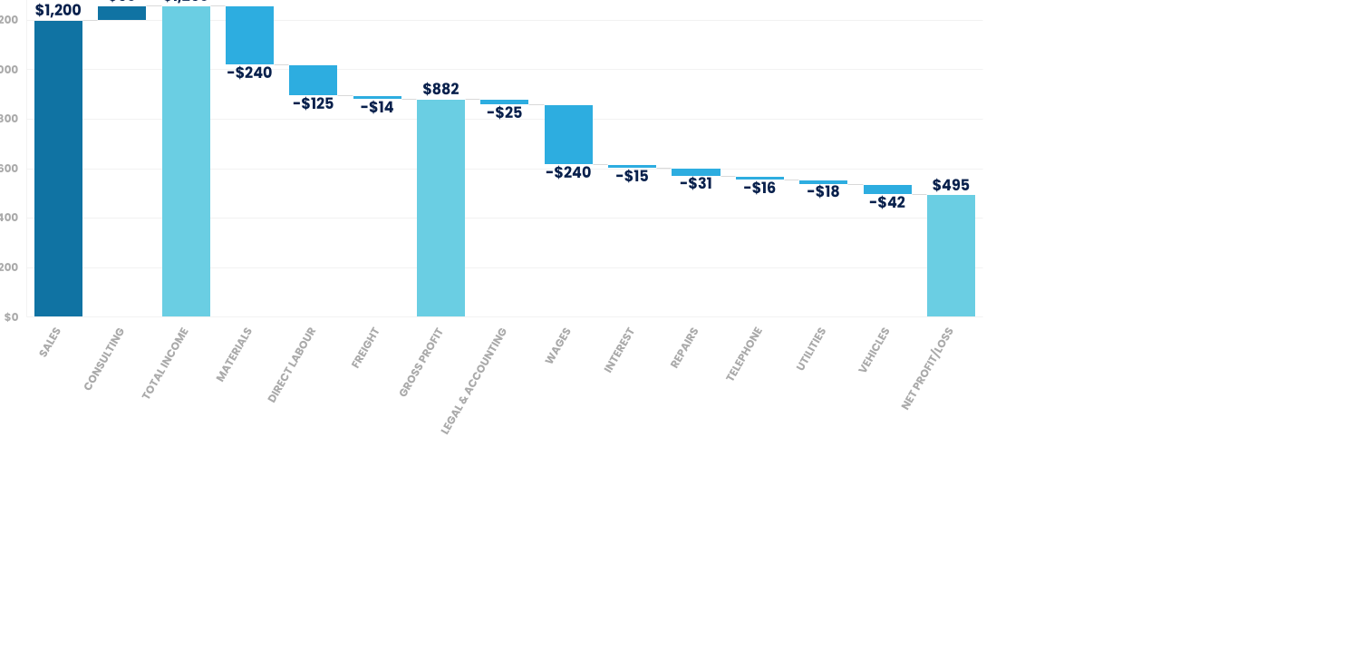
WATERFALL CHART
WATERFLOW CHART TEMPLATE

Slide 25
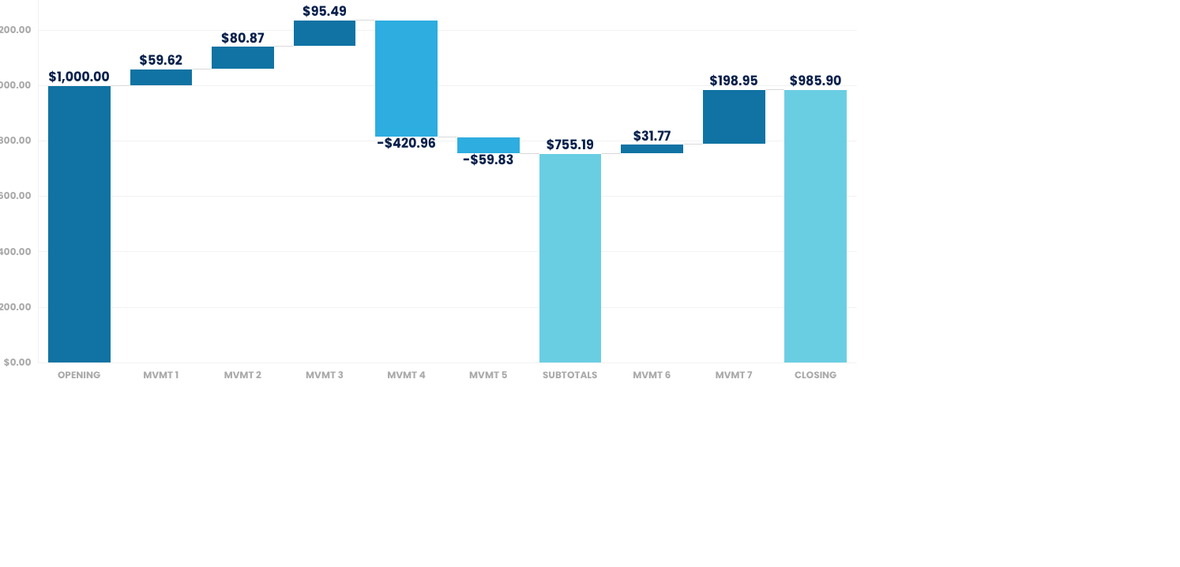
WATERFALL CHART
WATERFLOW CHART TEMPLATE

Slide 26
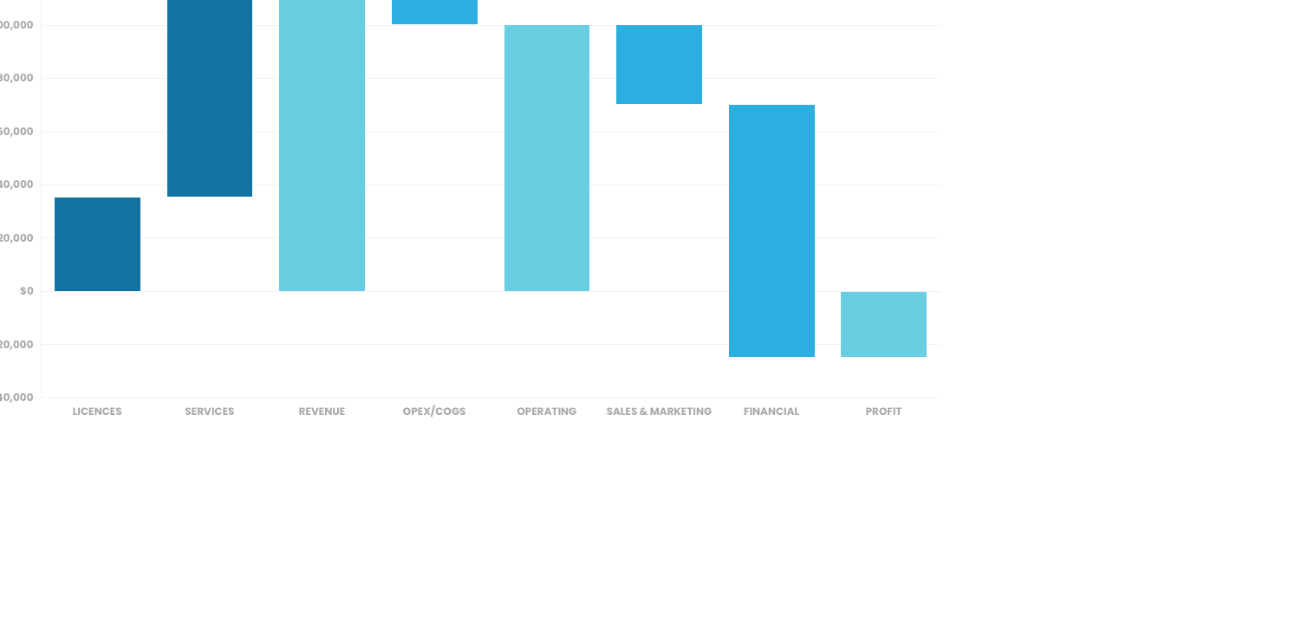
WATERFALL CHART
WATERFLOW CHART TEMPLATE

Slide 27
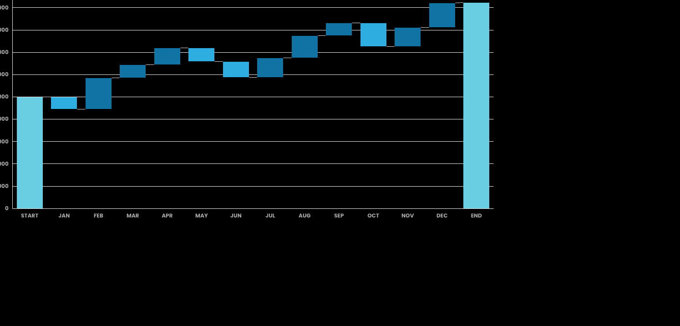
WATERFALL CHART
WATERFLOW CHART TEMPLATE

Slide 28
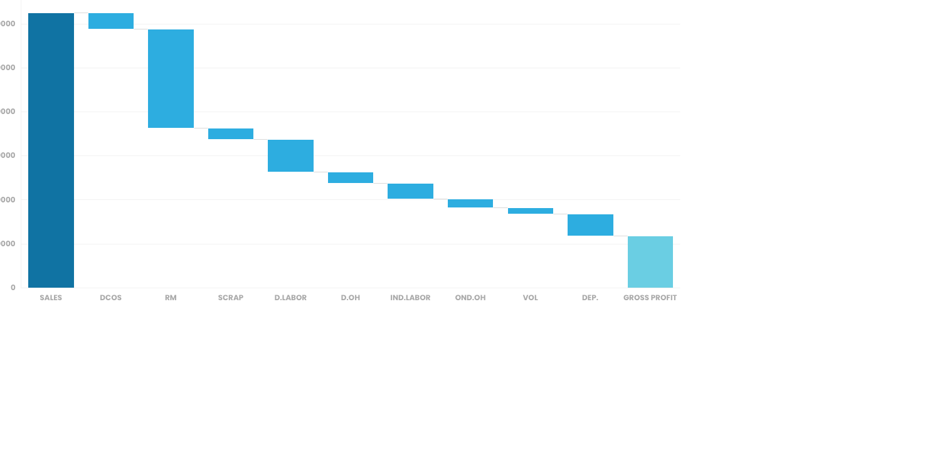
WATERFALL CHART
WATERFLOW CHART TEMPLATE

Slide 29
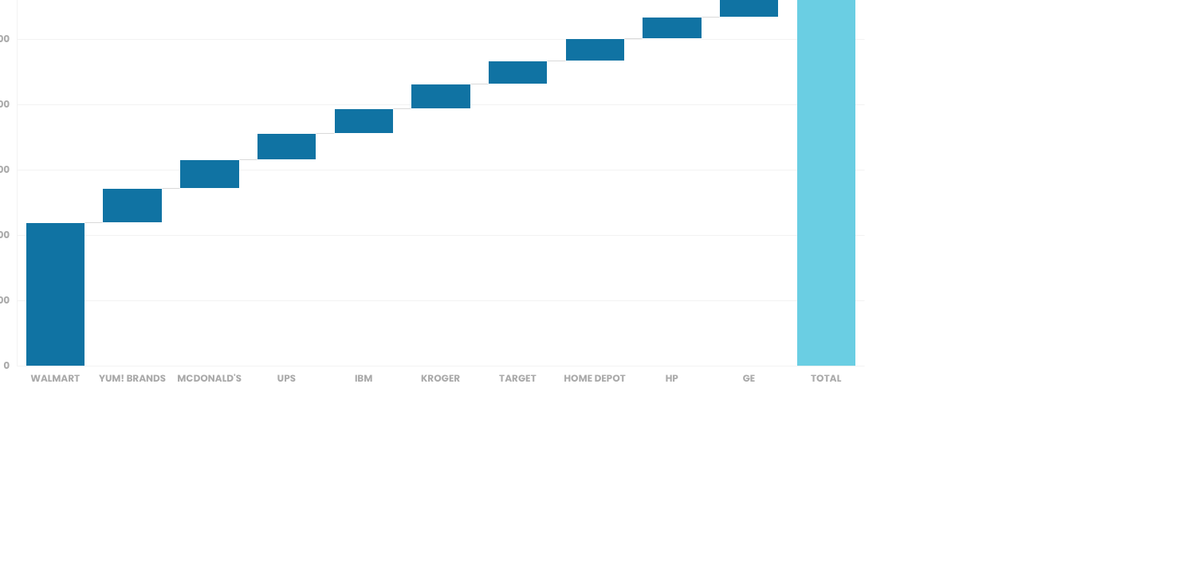
WATERFALL CHART
WATERFLOW CHART TEMPLATE

Slide 30
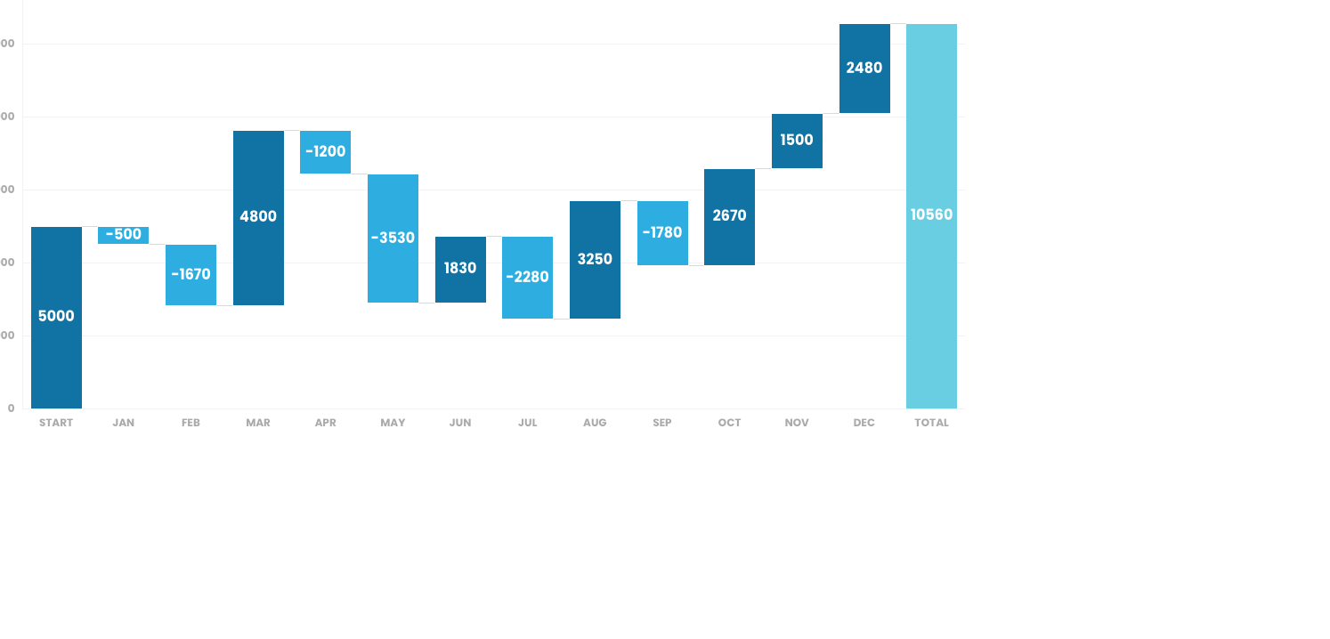
WATERFALL CHART
WATERFLOW CHART TEMPLATE

